Slide 1
Parent Workshop: Understanding SEND at Burghclere

Slide 2
Welcome & Aims of the Session
Welcome parents and carers.
To give an overview of SEND
How support works at Burghclere
Introduce Hampshire’s Ordinarily Available Provision (OAP) document.
Questions at the end.

Slide 3
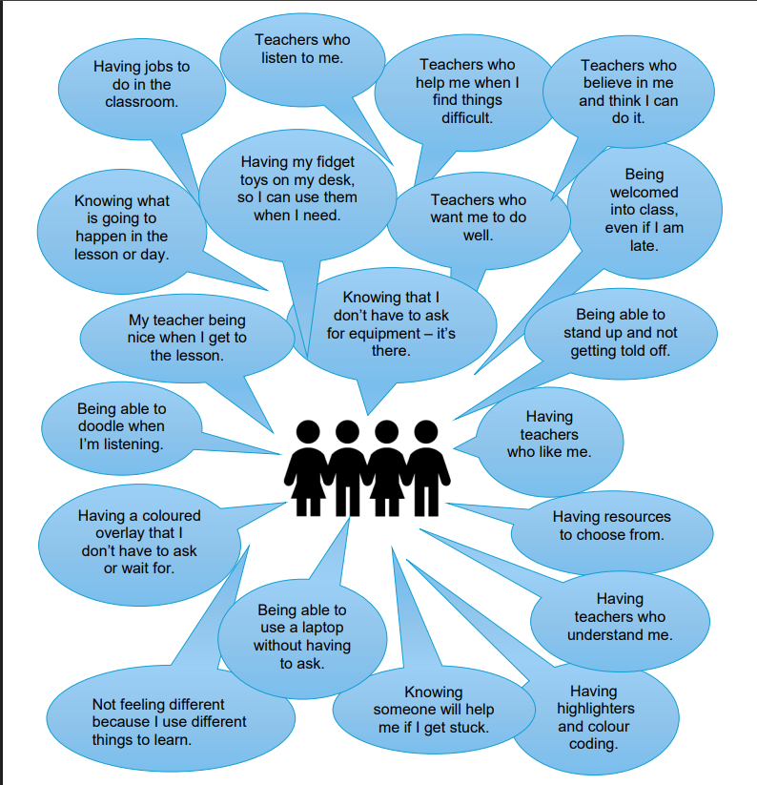

Slide 4
What is SEND?
Definition: Special Educational Needs and Disabilities (SEND) means children who have learning difficulties or disabilities that make it harder for them to learn than most children of the same age.
Areas of need:
Communication and Interaction,
Cognition and Learning,
Social, Emotional and Mental Health,
Sensory and/or Physical needs.

Slide 5
SEND Support at Burghclere
High-quality, inclusive teaching for all.
Differentiated tasks, scaffolding, and personalised approaches.
Targeted interventions where needed.
Working closely with parents, carers, and outside professionals.
Regular reviews.

Slide 6
How we as a school support emotional wellbeing
Attunement
We notice and respond to children’s emotional signals (tone of voice, body language, expressions).
Staff use calm voices, warm eye contact, and reflective listening.
We “tune in” by being present and showing children they are understood.
Validation
We acknowledge children’s feelings without judgment (e.g., “I can see you’re feeling upset”).
We reassure them that all feelings are normal and safe to share.
We help children name their emotions and connect them to strategies for coping.
Why this matters
✅ Builds trust and safety
✅ Strengthens emotional resilience
✅ Supports positive behaviour and learning

Slide 7
What is Ordinarily Available Provision (OAP)?
Definition: Support and strategies that all schools in Hampshire are expected to provide as part of everyday teaching.
OAP helps ensure consistency and quality across schools.
It sets out what children should receive without the need for an Education, Health and Care Plan (EHCP).

Slide 8
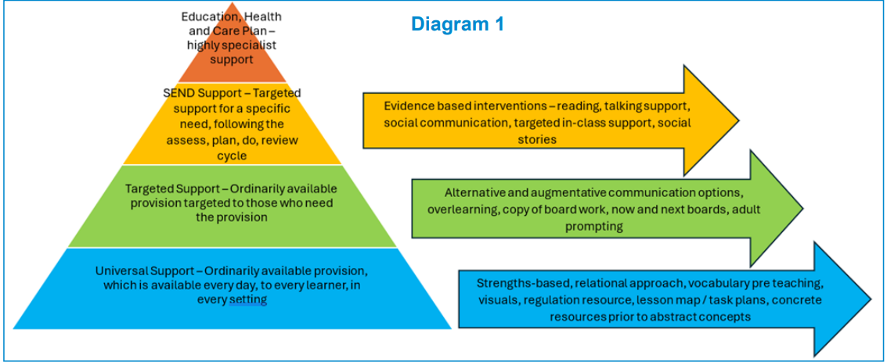

Slide 9
Key Principles
Inclusive practice – All teachers are responsible for every child’s progress, including those with SEND.
Consistency across schools – Children should receive the same high-quality support in any Hampshire school.
Early intervention – Strategies are in place quickly, without waiting for a diagnosis.
Partnership – Schools work with parents and pupils to shape support.

Slide 10
Examples of OAP Support
In the classroom:
Differentiated work and scaffolding.
Visual timetables and clear routines.
Use of assistive resources (e.g., coloured overlays, enlarged text, pencil grips).
Small group or one-to-one support for specific skills.
For emotional and social needs:
Check-ins and mentoring.
Safe spaces or quiet areas.
Strategies for managing behaviour and supporting wellbeing.
For communication and interaction:
Use of visuals, symbols, or sign support.
Pre-teaching of key vocabulary.
Opportunities for structured talk and interaction.

Slide 11
What This Means for Families
Every child should benefit from inclusive strategies in the classroom.
Support is available straight away, without needing formal assessments.
Parents should see evidence of OAP in their child’s day-to-day learning.
If a child needs more than OAP, schools can consider additional resources or request an EHCP.
Parents kept informed through meetings, reports, and workshops.

Slide 12
How We Identify Children’s Needs at Burghclere
Teacher Observations
Daily classroom observations of learning, behaviour, and wellbeing.
Teachers notice patterns, strengths, and areas of difficulty.
Assessment & Data
Tracking pupil progress through testing (e.g., phonics screening, reading, maths).
Looking at results over time to spot gaps or concerns.
SEN Checklists
Structured identification tools aligned to the four key SEN areas:
  Cognition & Learning
  Communication & Interaction
  Social, Emotional & Mental Health
  Sensory & Physical Needs
Tracking Interventions
Monitoring support strategies already in place.
Measuring progress to see what works best.
Adjusting provision when needed.
Our Goal
✅ Early identification
✅ Targeted support
✅ Partnership with parents

Slide 13
What is an IEP (Individual Education Plan)?
An IEP is a personalised plan to support a child’s learning needs.
It is created when a child needs additional help to succeed in school.
Key points for parents:
Personalised Goals: The IEP sets out specific, realistic learning and development targets tailored to the child.
Collaborative Process: Teachers, support staff, parents, and sometimes the child, work together to create and review the plan.
Focused Support: It outlines the strategies, resources, and teaching approaches that will help the child reach their goals.
Regular Reviews: Progress is monitored, and the plan is updated regularly termly.
Parent Involvement: Parents’ insights are valued – you know your child best, and your voice helps shape the plan.

Slide 14
Summary
SEND = additional needs that require support.
SEND Code of Practice shapes everything we do.
Burghclere provides inclusive teaching and targeted support.
Hampshire’s OAP ensures consistent, high-quality provision.
Partnership with parents is key.
Ofsted Inspection July 2025
“Pupils with SEND have their needs identified accurately by the school. Teachers adapt learning to support pupils to access the whole curriculum. The school provides pupils with personalised support, which helps them to build their knowledge. The school works with parents and carers and pupils with SEND to set targets and review progress on a regular basis.”

