Slide 1

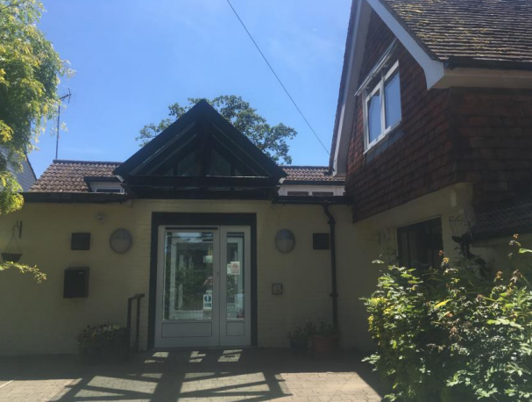
Welcome to
My journey starts here…​

Slide 2

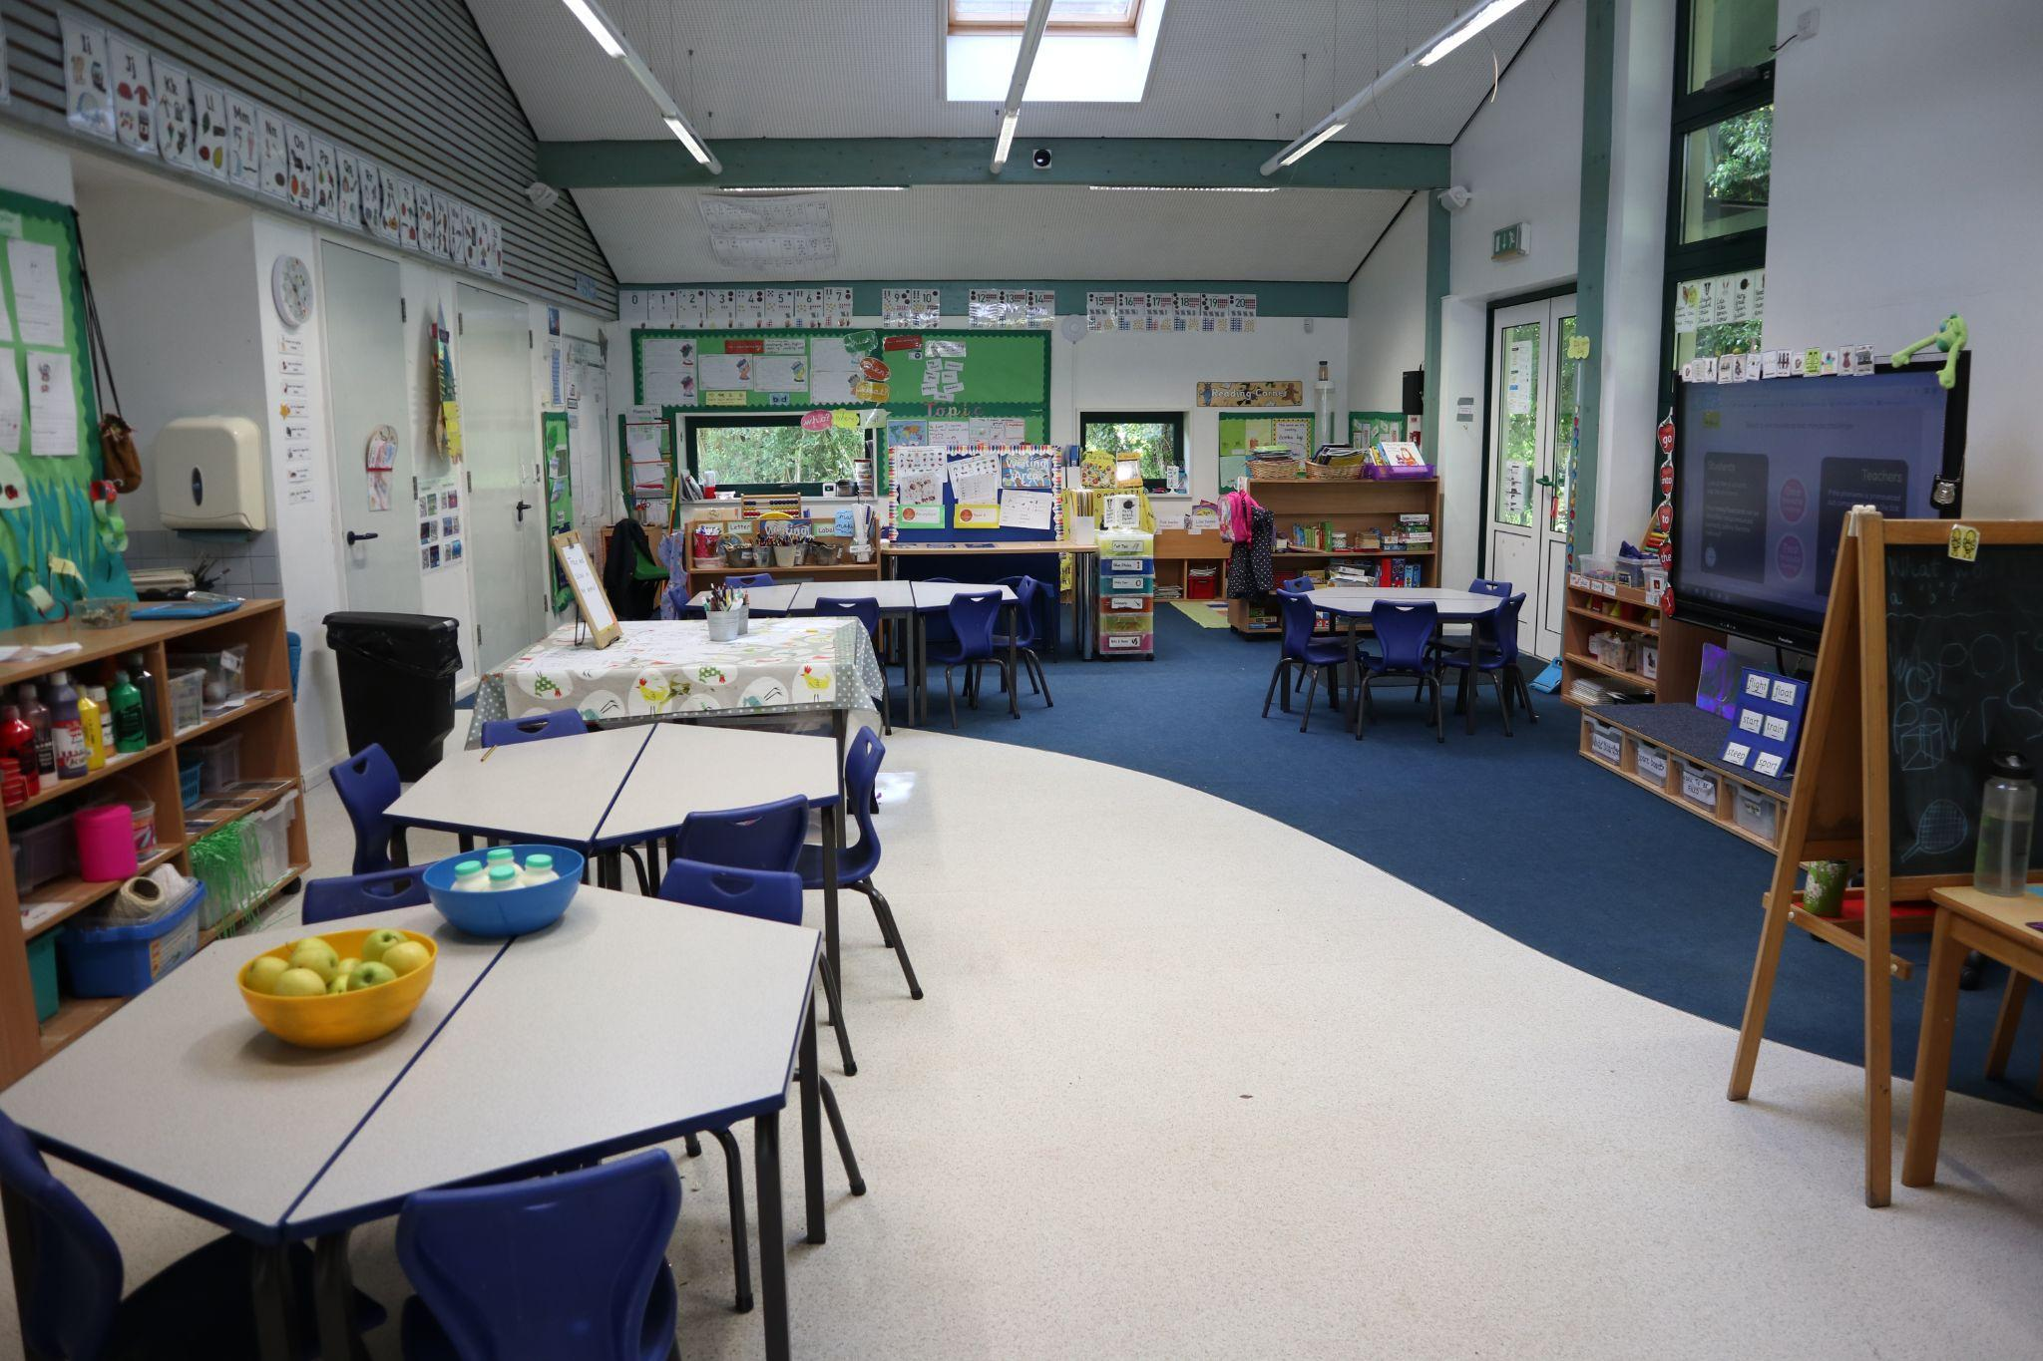
In September, I will be in Acorn Class. I will be in year R.
This is my classroom…

Slide 3
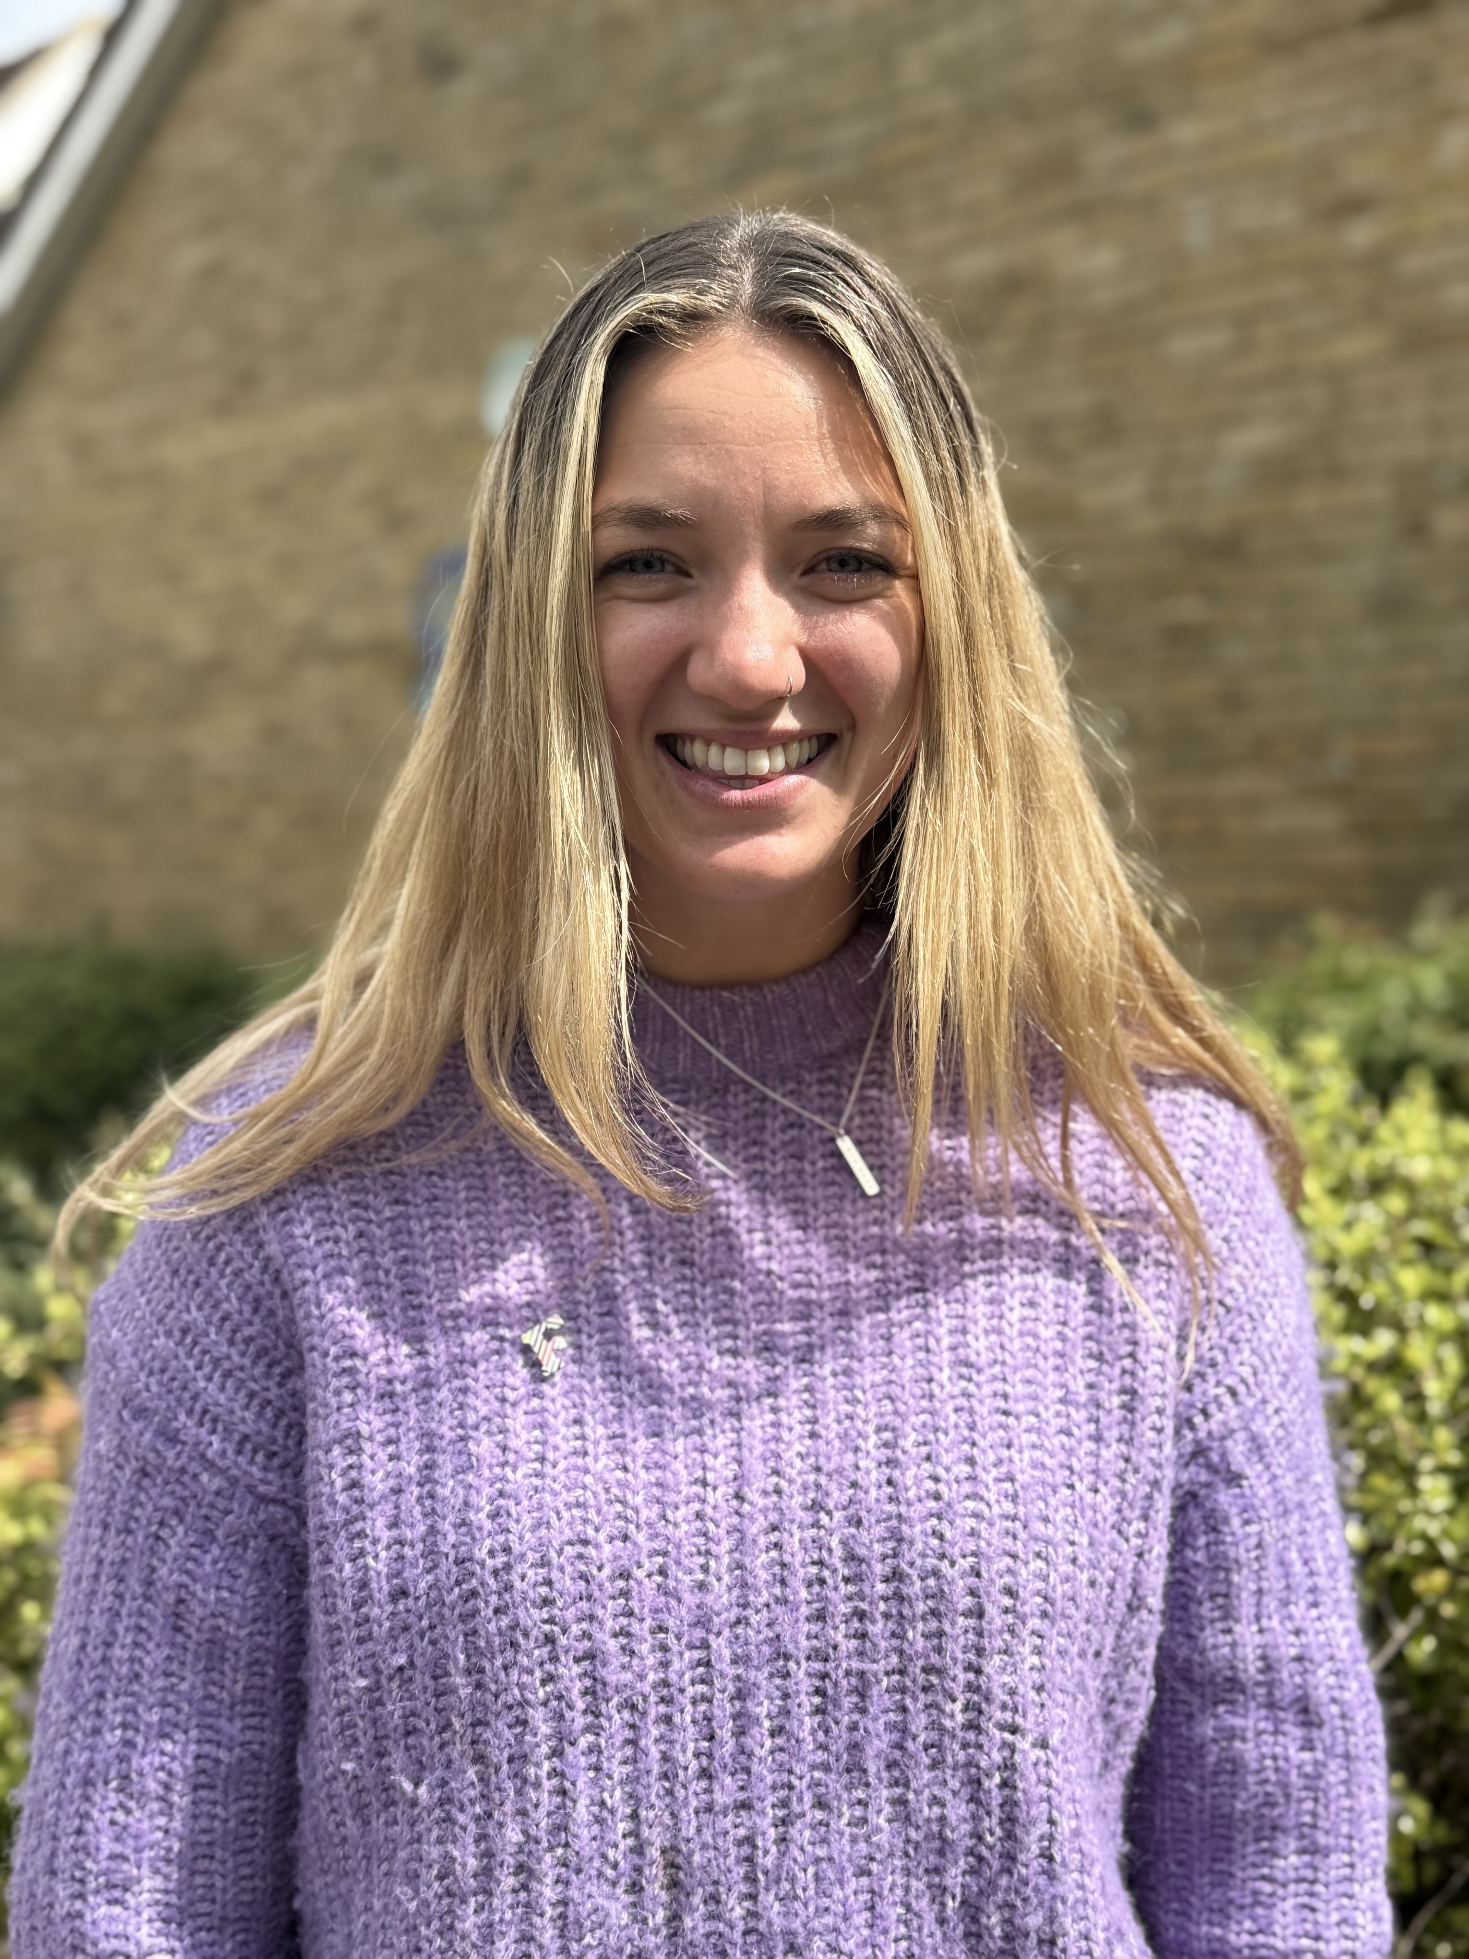
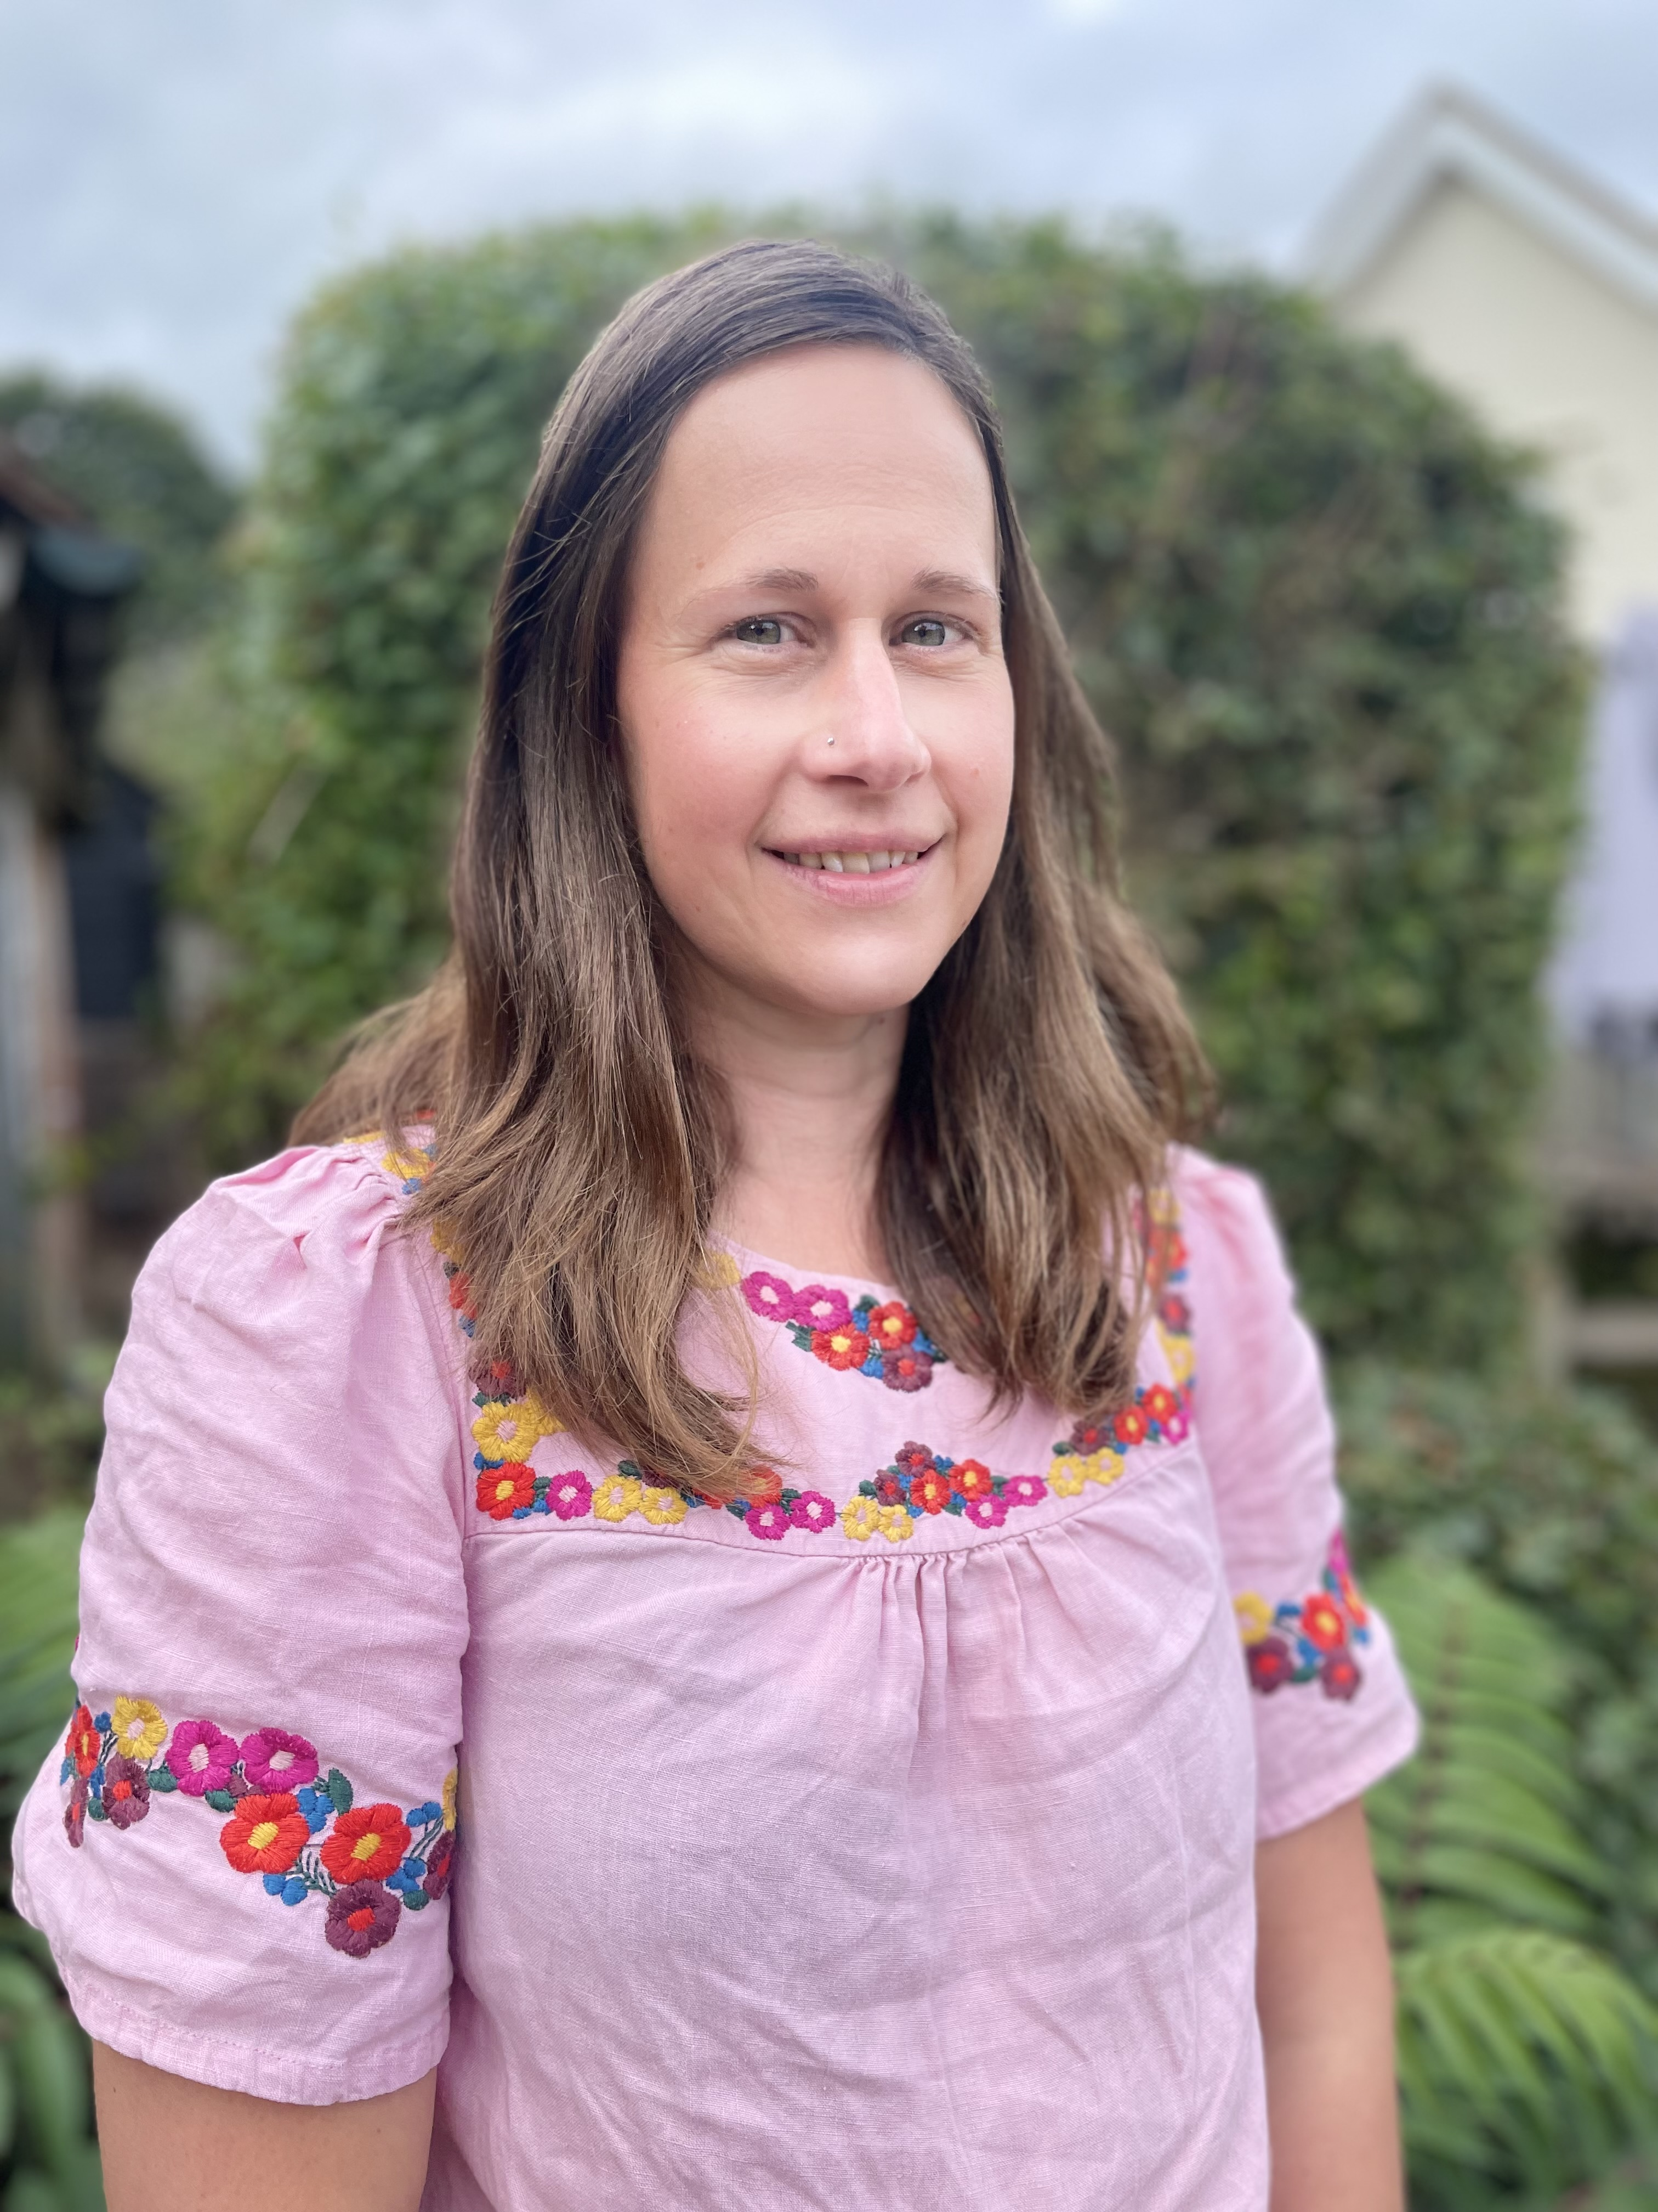
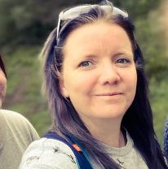
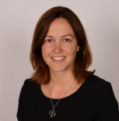
My teacher will be Miss Rist…
…The other adults helping me will be
Mrs Hope
Mrs Laidlaw
My headteacher is Mrs Letchford

Slide 4
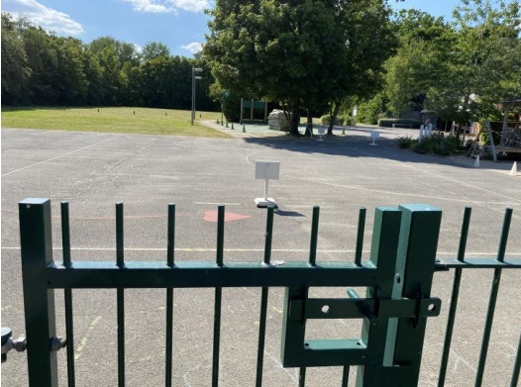
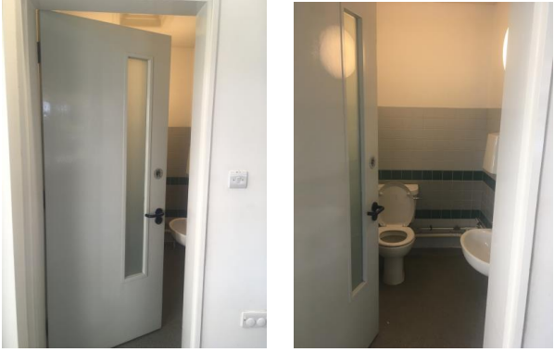
This is where I will say goodbye to my adult…
…This will be the toilet I use

Slide 5
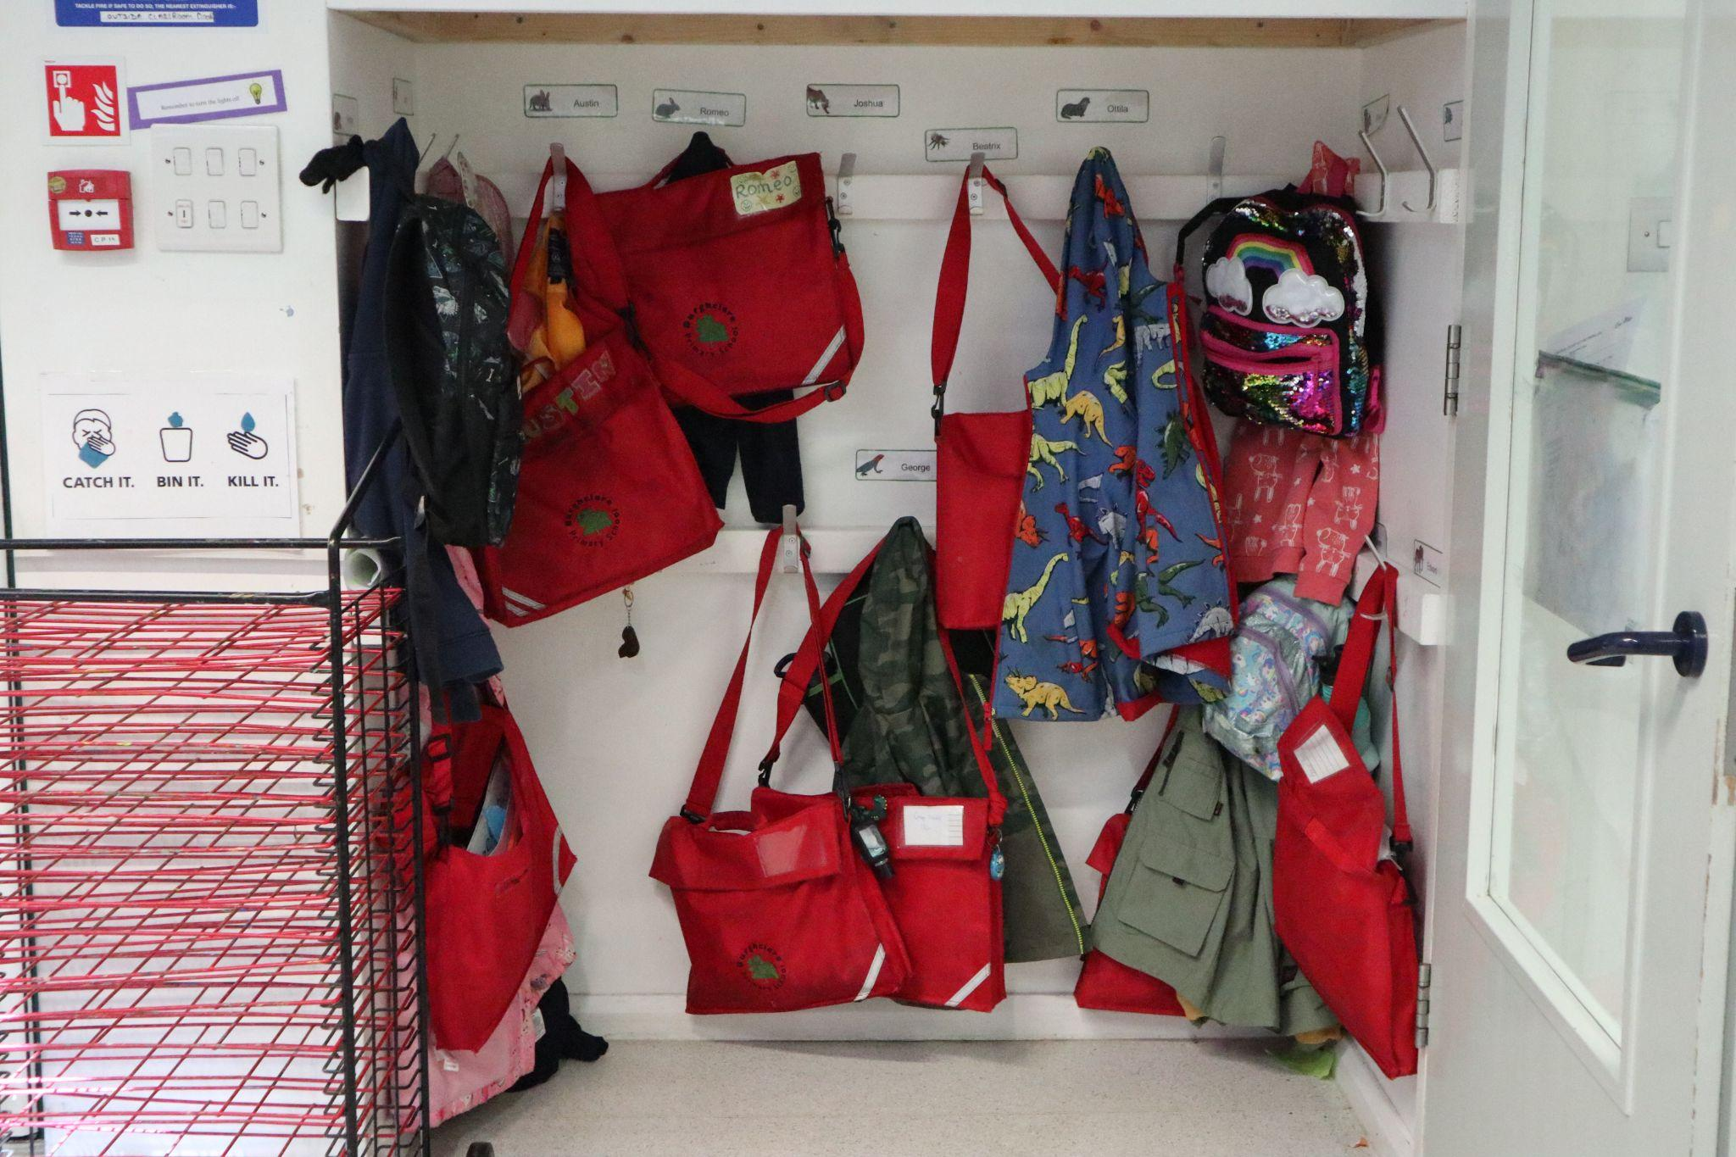
This is where I will hang my coat and bag…

Slide 6
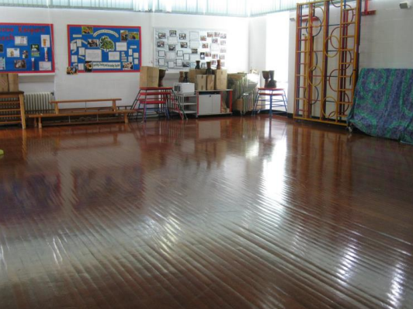
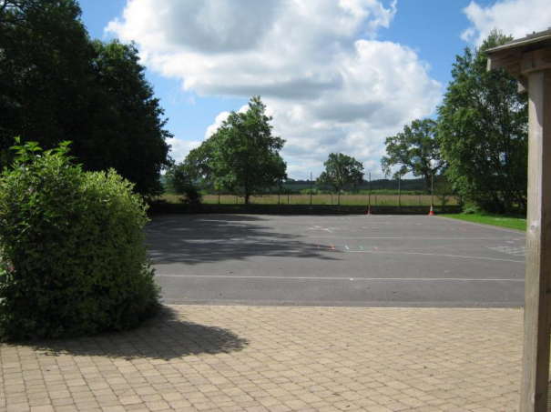
I will have my lunch in the hall…
…I will play in the playground

Slide 7
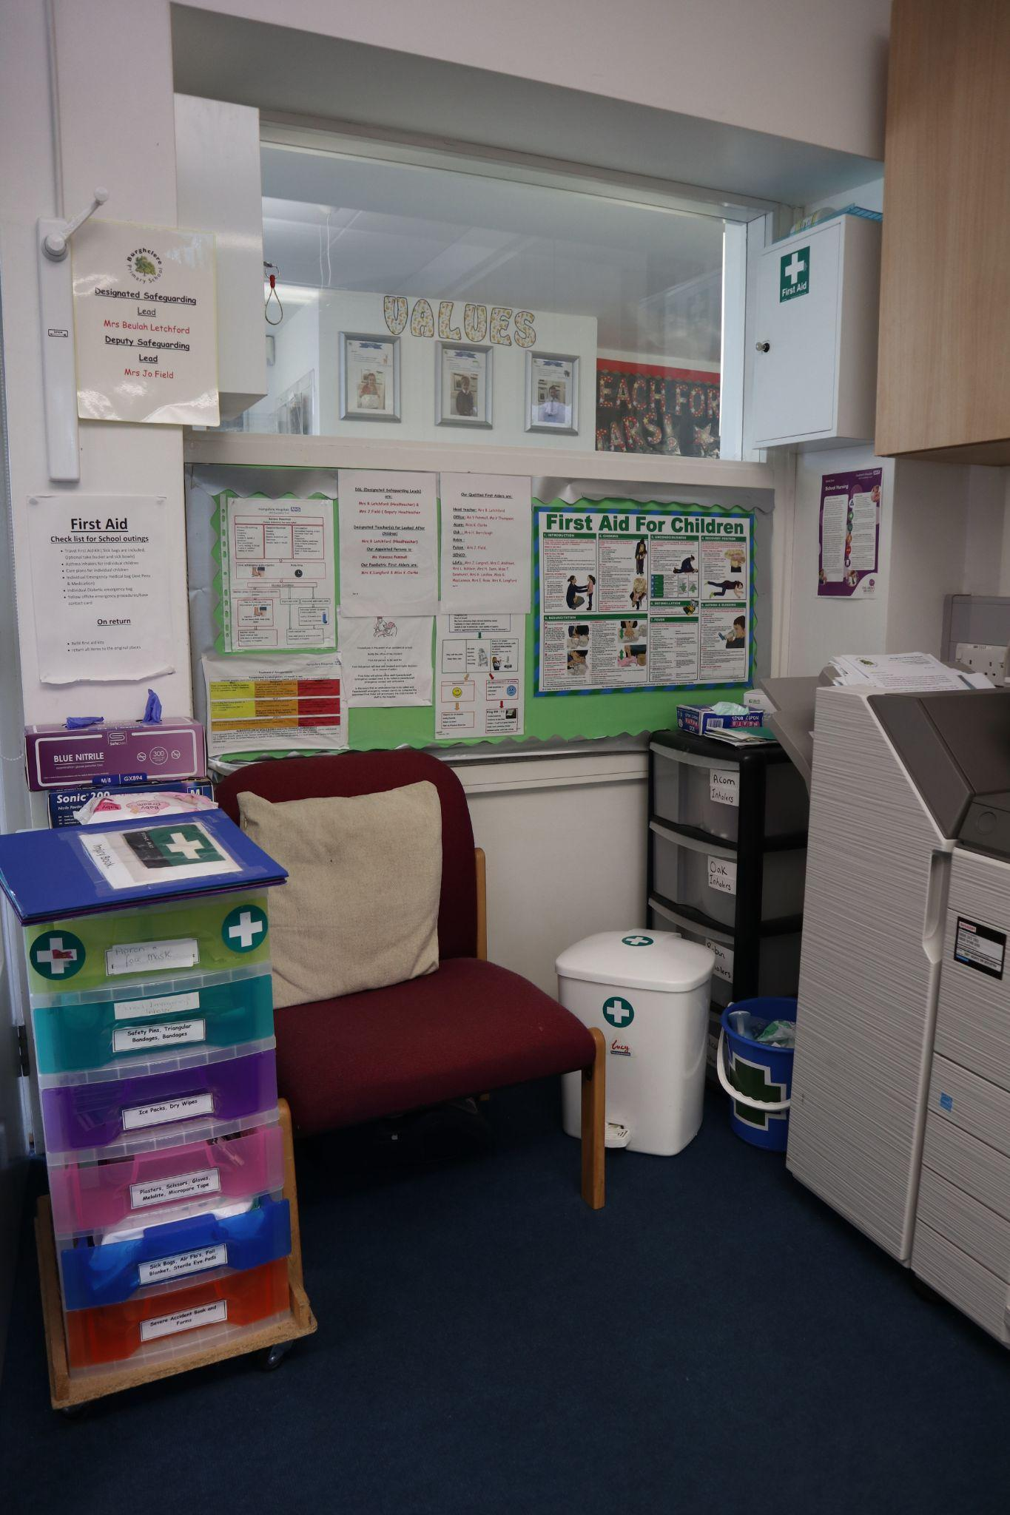
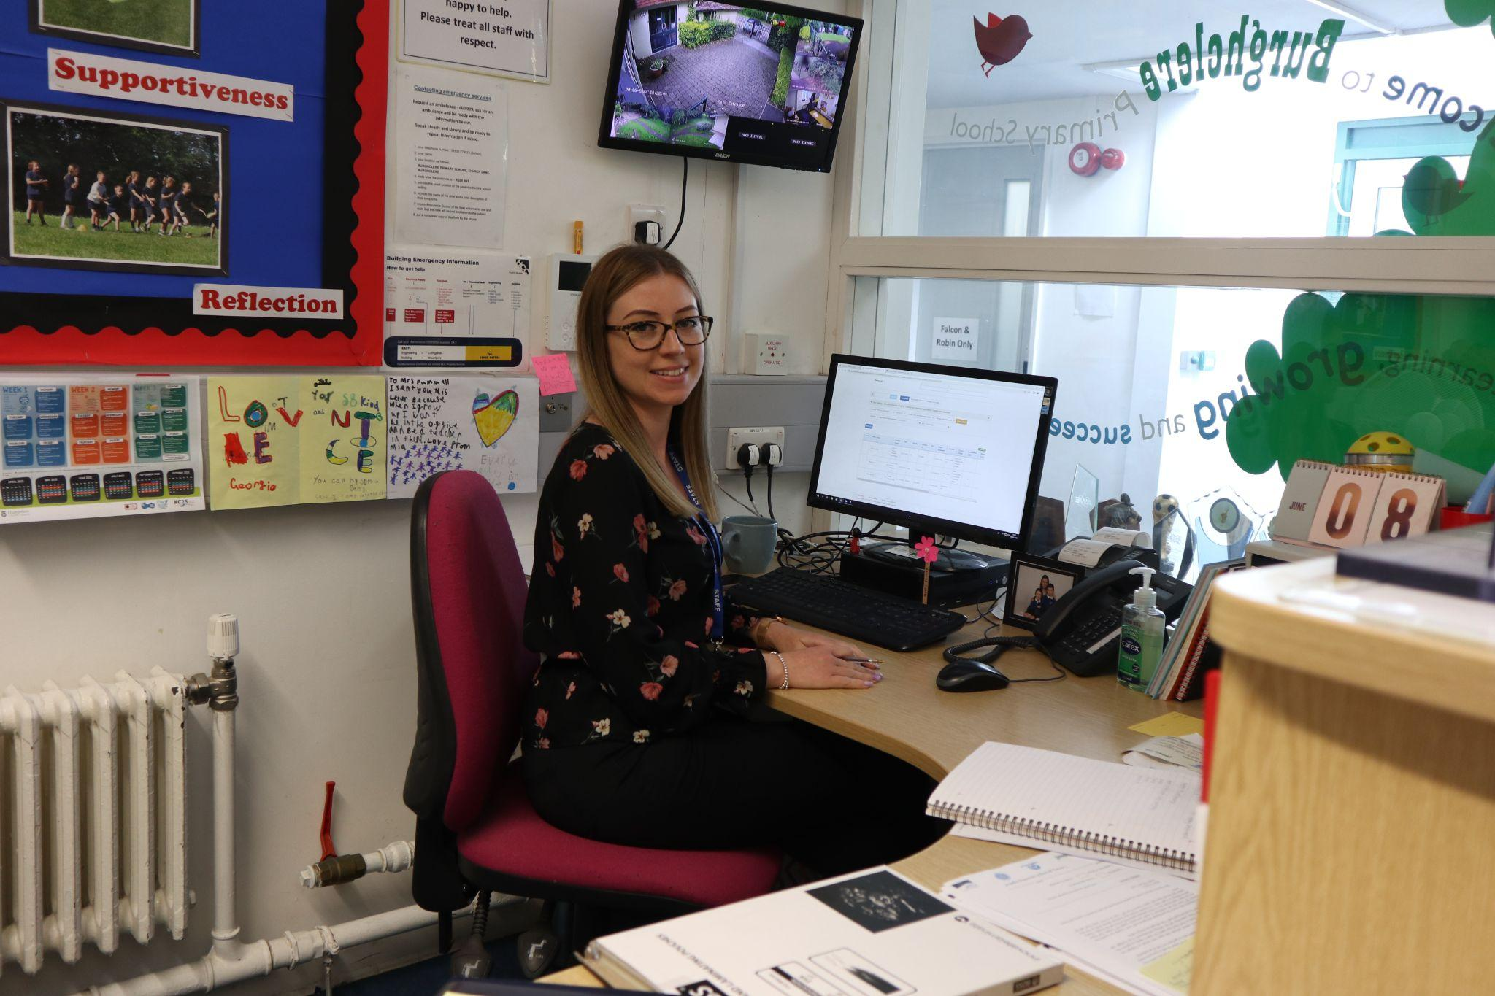
This is Miss Pummel, she will be in the main office incase I need any first aid or help.
This is the first aid area…

Slide 8
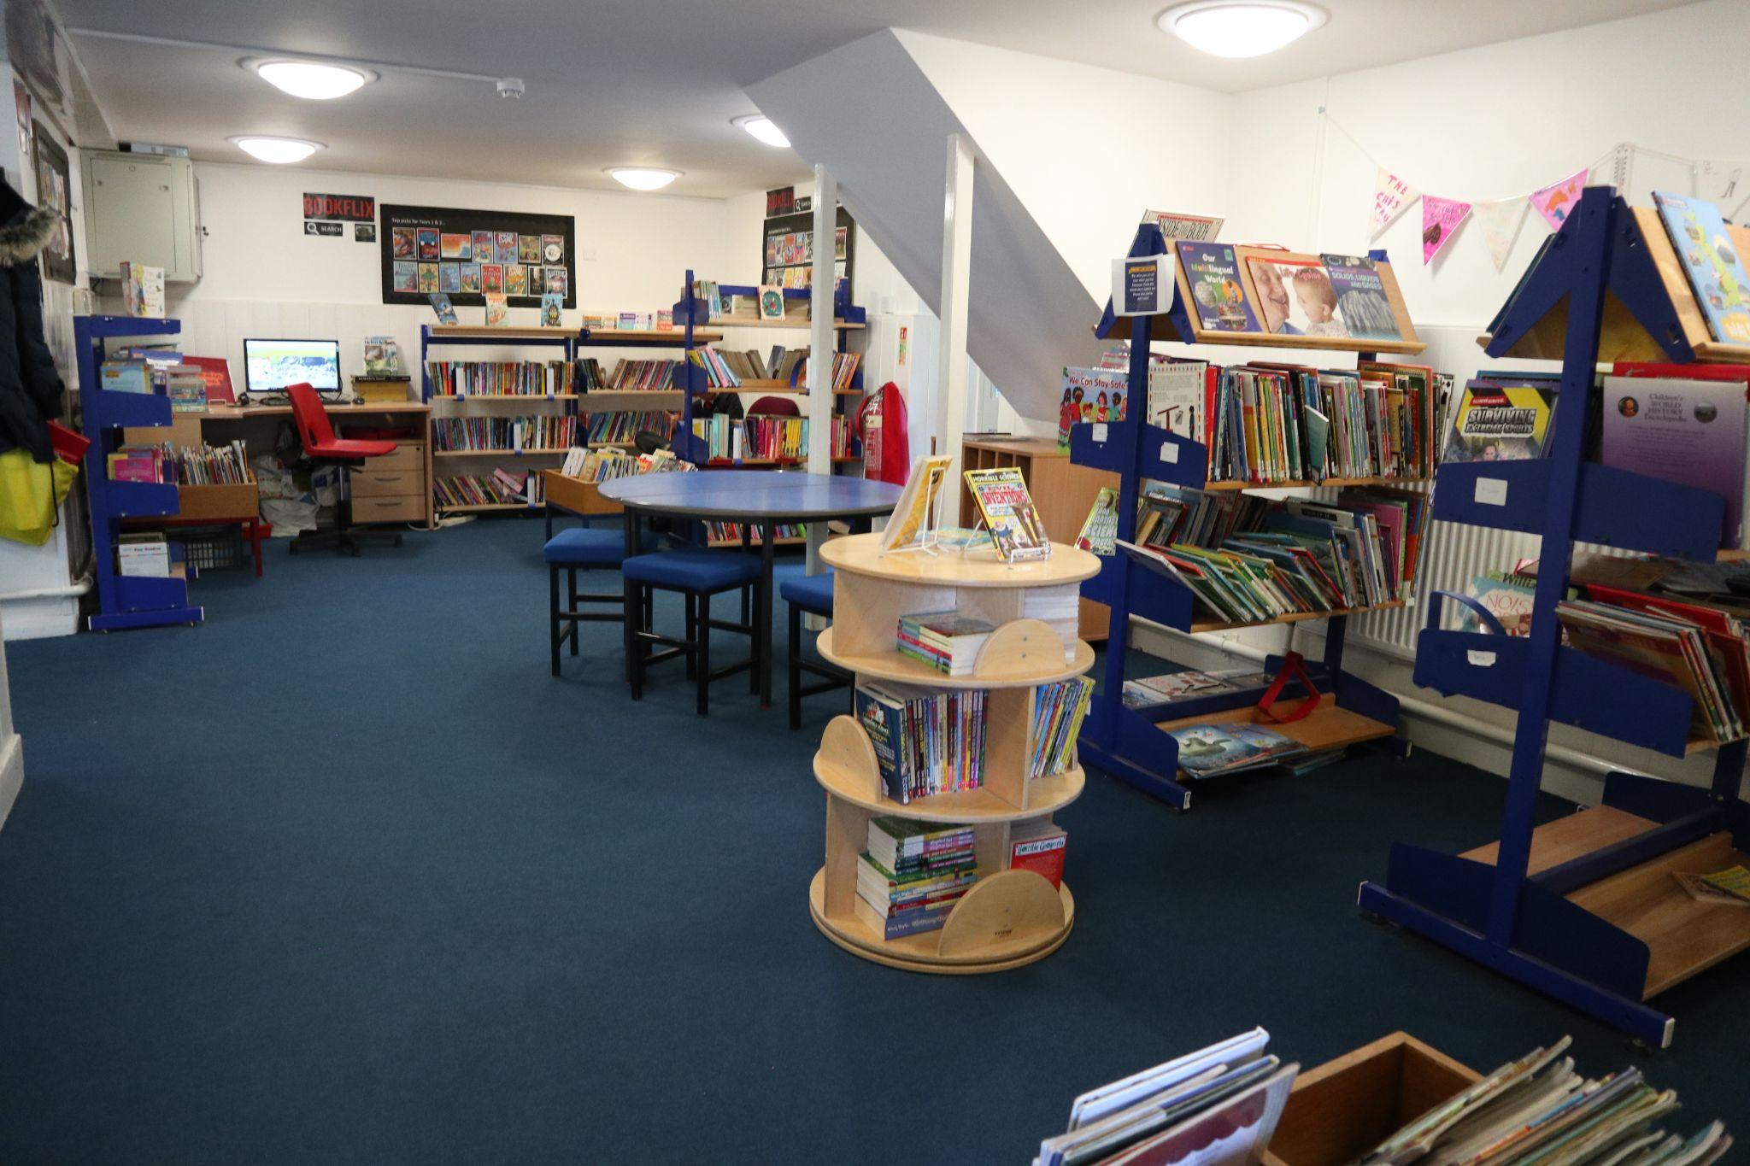
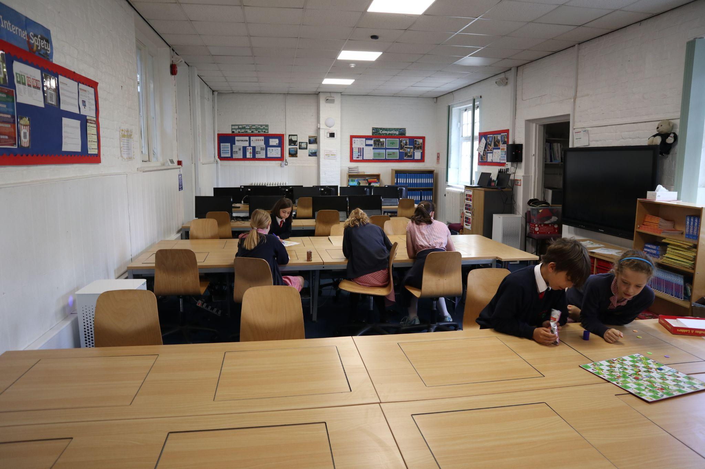
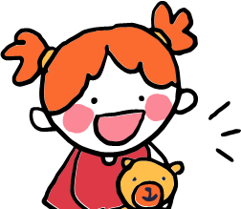
Other places I might spend time are…
The Library
The After School Club

Slide 9
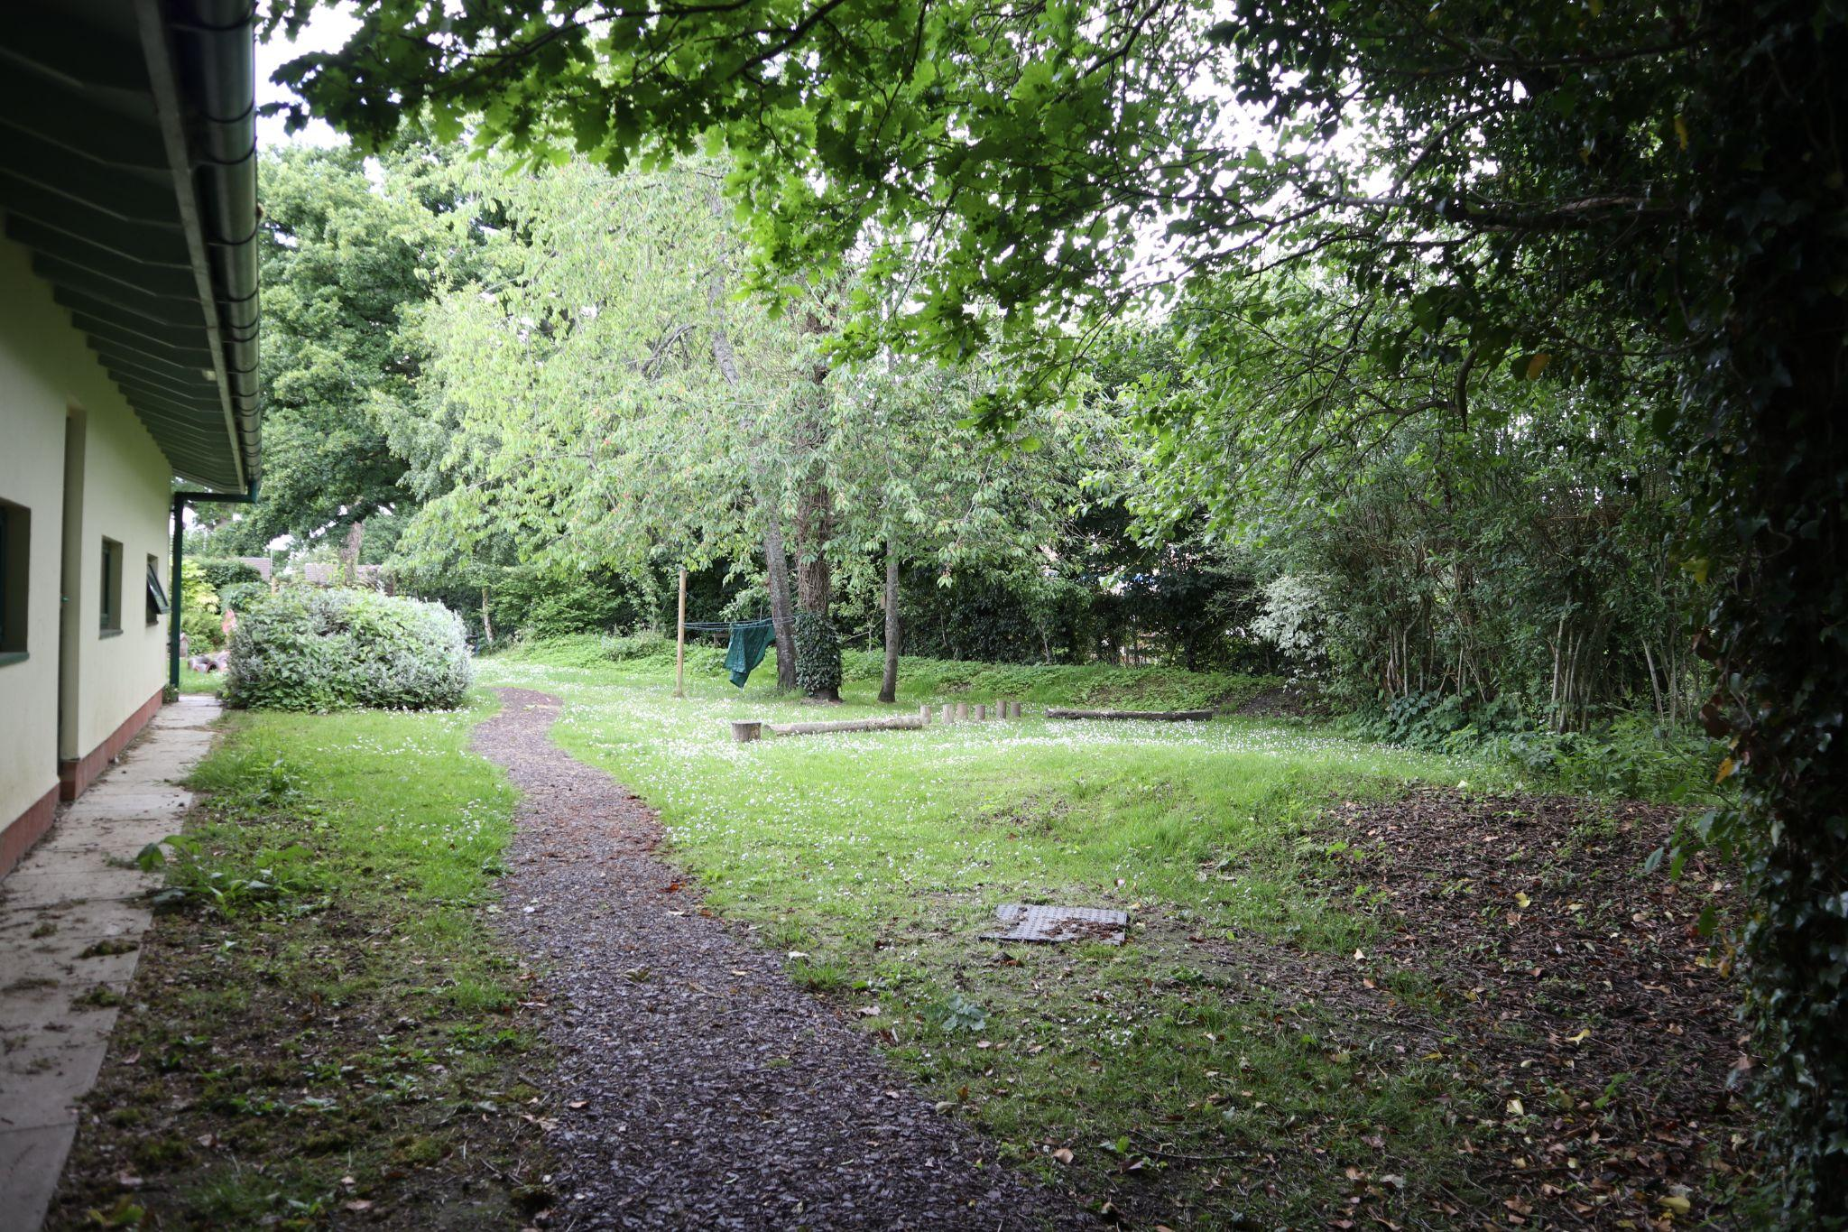
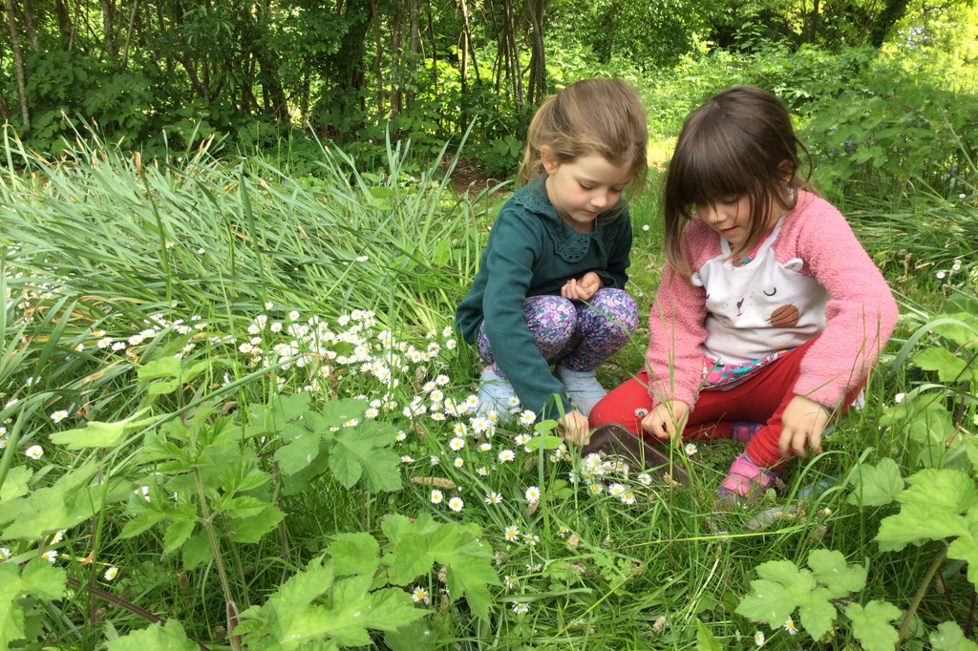
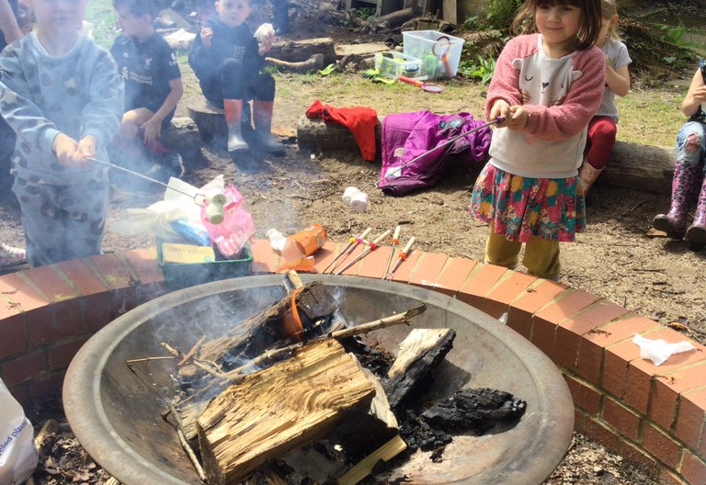
This is the area we will have Outdoor Learning in!

Slide 10

I will finish school at 3:10…

